Slide 1
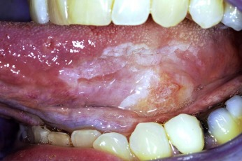
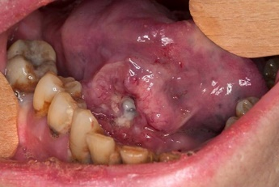
Oral Cancer Research Multi-OMICs Approach Identifying the top biomarker Using ML models
Soumitra Darshan Nayak
22B0984

Slide 2
My Progress:-
I am working on the NAT vs Tumor dataset to identify the top biomarkers. The dataset contains 84 samples with 3612 features (Protein Expressiveness data) for each sample.
First, I simulated the Covid Practice Dataset to find the accuracy of various Machine Learning models and their prediction probability for severe and non-severe classes.
The ML models used in the Covid Practice dataset are SVM, KNN, Naïve Bayes, Random Forest and Logistic Regression.
I followed some research papers on feature selection in proteomics and genetic data, and I found that in most cases, SVM and Random Forest models with some penalties like Lasso regression and elastic net are used to identify the top biomarkers.

Slide 3
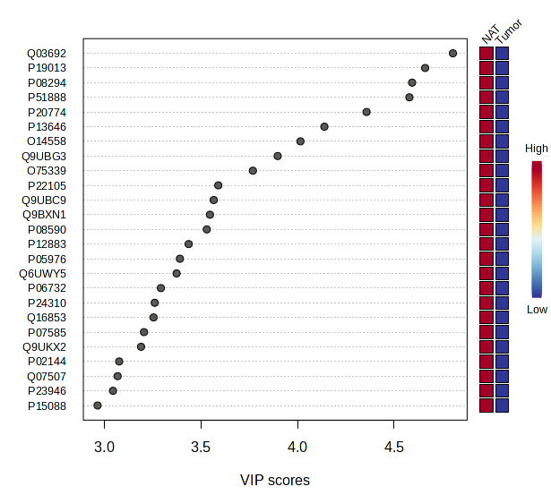
My Progress:-
I have used the metaboanalyst.ca website to find the top 894 proteins based on the PLS-DA (Partial Least Square Discriminant Analysis) metric, which has a VIP score of > 1.
The VIP (Variable Importance in Projection) score is a metric used in Partial Least Squares Discriminant Analysis (PLS-DA) to determine the importance of each variable (or feature) in predicting the response variable.
So, my task is to find a subset of these 894 proteins containing top biomarkers.

Slide 4
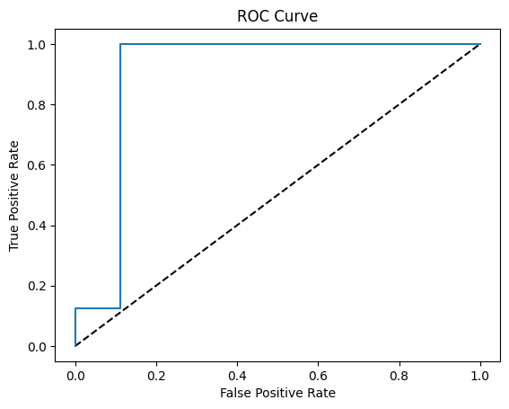
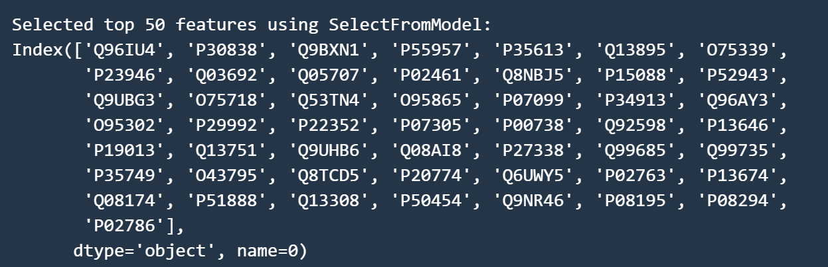
Logistic Regression:-
I modified the dataset to contain only these 894 relevant proteins selected based on Vip score > 1.
Then, I used Logistic Regression with Elastic Net Regularization to find the top 50 proteins based on their importance in classification.
5-fold Cross-validation accuracy:- 84.54%
Accuracy with the top 50 proteins:- 94%

Slide 5
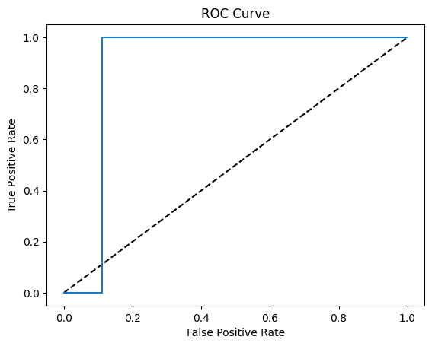
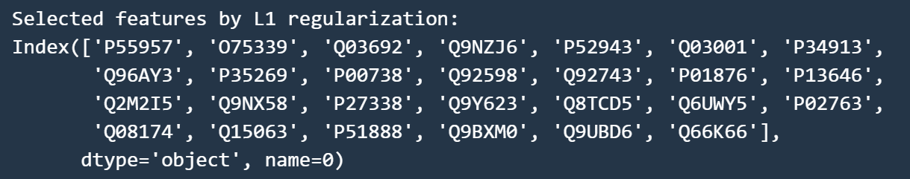
SVM with Lasso Regression:-
Then, I used SVM model with Lasso Regression to find the top proteins based on their coefficients.
Ultimately, 27 proteins were selected, as Lasso regression sets the coefficients of irrelevant features to zero.
5-fold Cross-validation accuracy:- 98.57%
Accuracy with the top features:- 94.11%

Slide 6
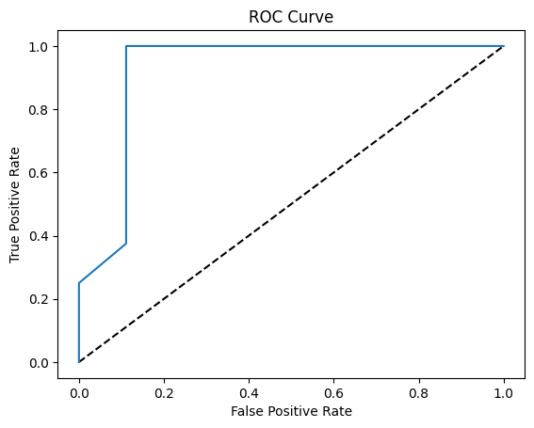
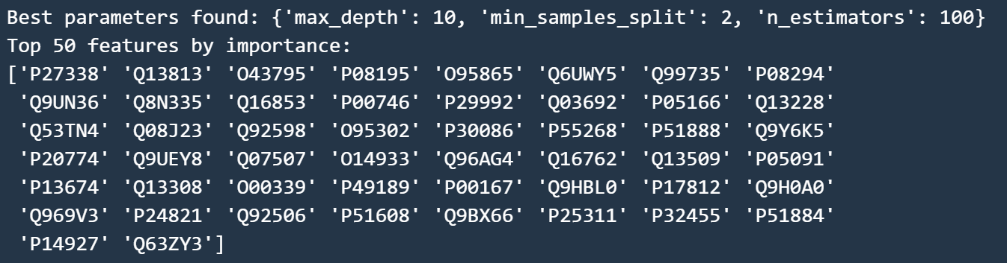
Random Forest Model:-
I used the Random Forest model to identify the top 50 proteins based on their importance.
5-fold Cross-validation accuracy:- 98.57%
Accuracy with the top features:- 94.11%

Slide 7
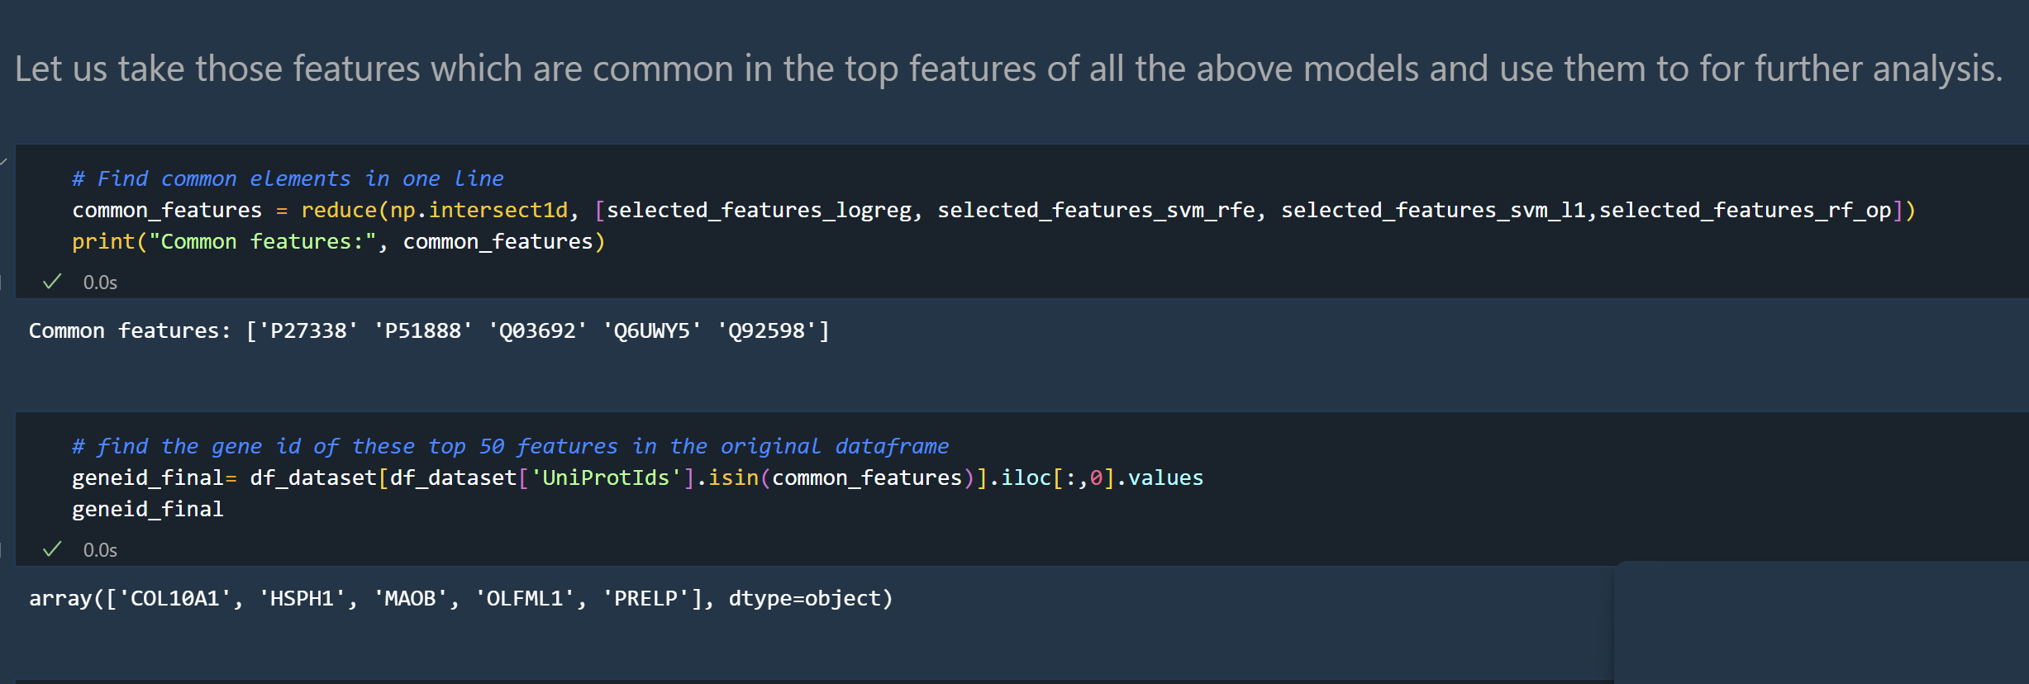
Common Proteins among all these Models:-

Slide 8
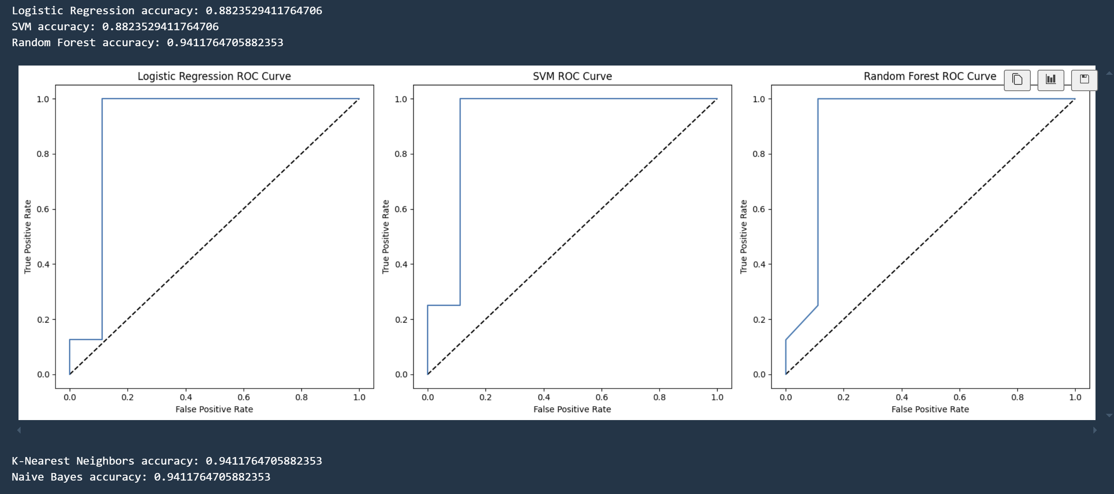
Testing all the models with these common proteins:-
Observed Random Forest performing better than the SVM model

Slide 9
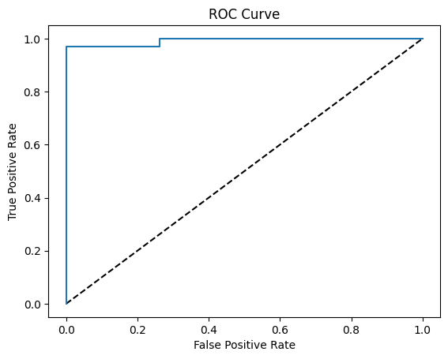

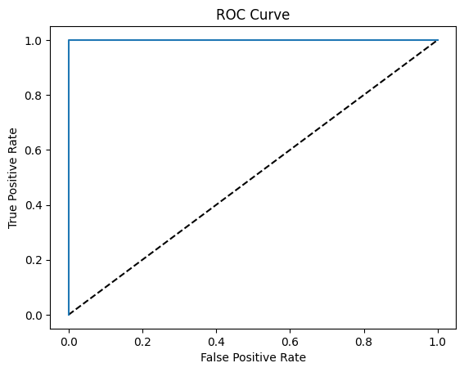
Testing the Common Proteins on CPTAC dataset:-
The CPTAC_TumorvsNormal dataset has 172 samples, each with 9666 protein expression data as features.
I used KNN imputation to impute the missing values using the 5 neighbourhoods.
I modified the dataset to contain only 5 features, which are the top proteins that were selected before based on their geneid.
Tested Logistic Regression with elastic net, Random Forest and SVM models on this modified dataset, and SVM gave 100% accuracy on the test set.
Logistic Regression
Cross-validation accuracy- 95.83%
Random Forest Model
Cross-validation accuracy- 97.5%
SVM model
Cross-validation accuracy- 97.85%

Slide 10
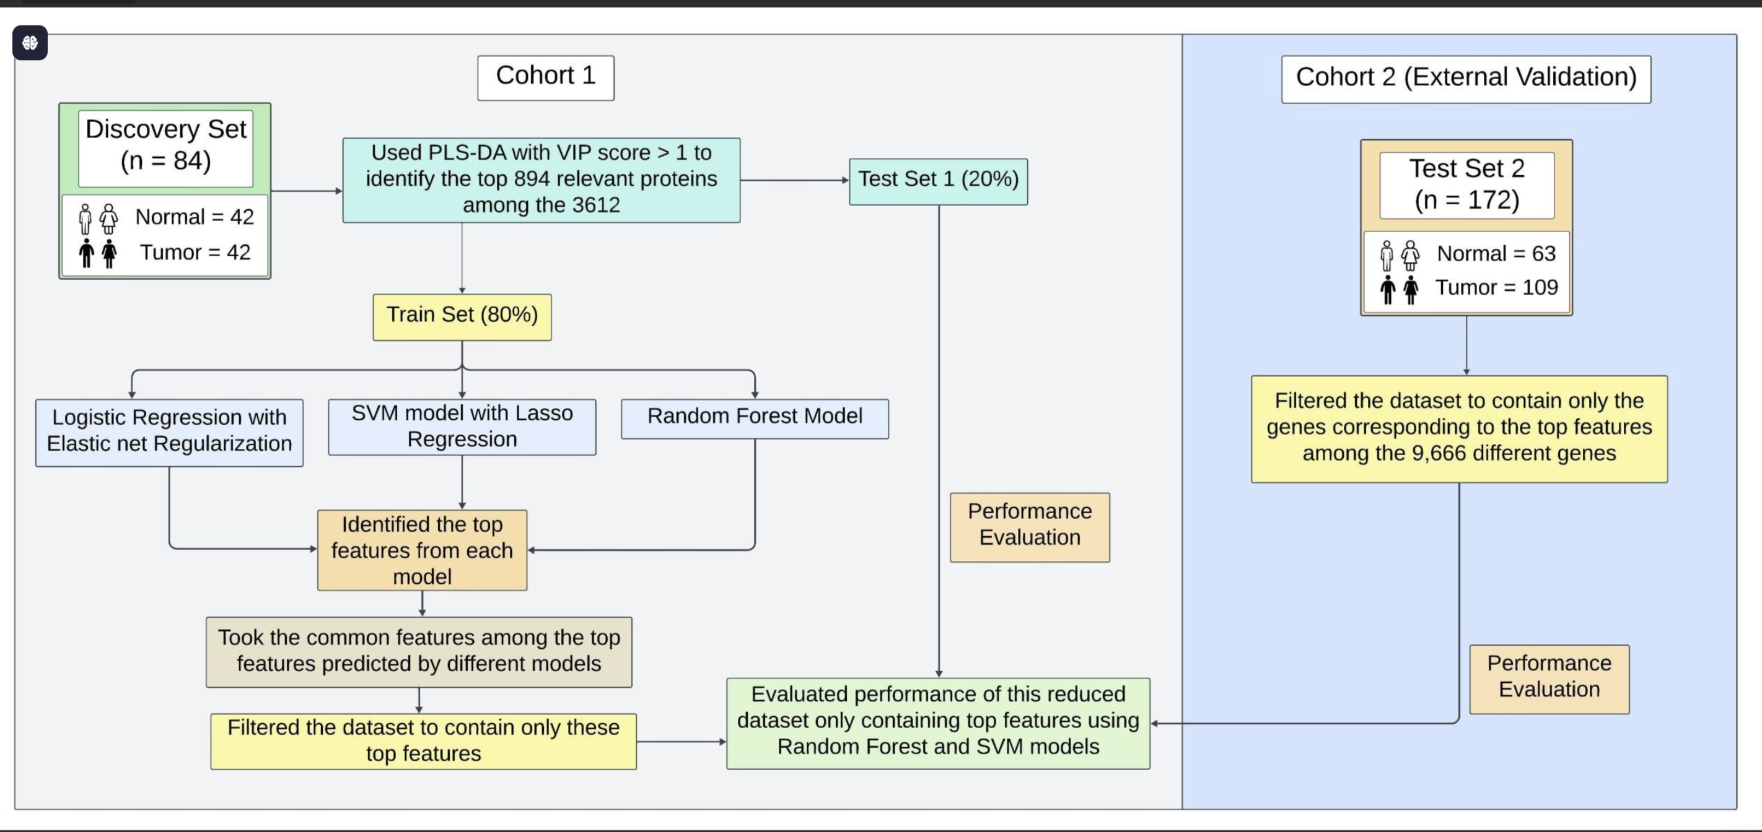

Slide 11
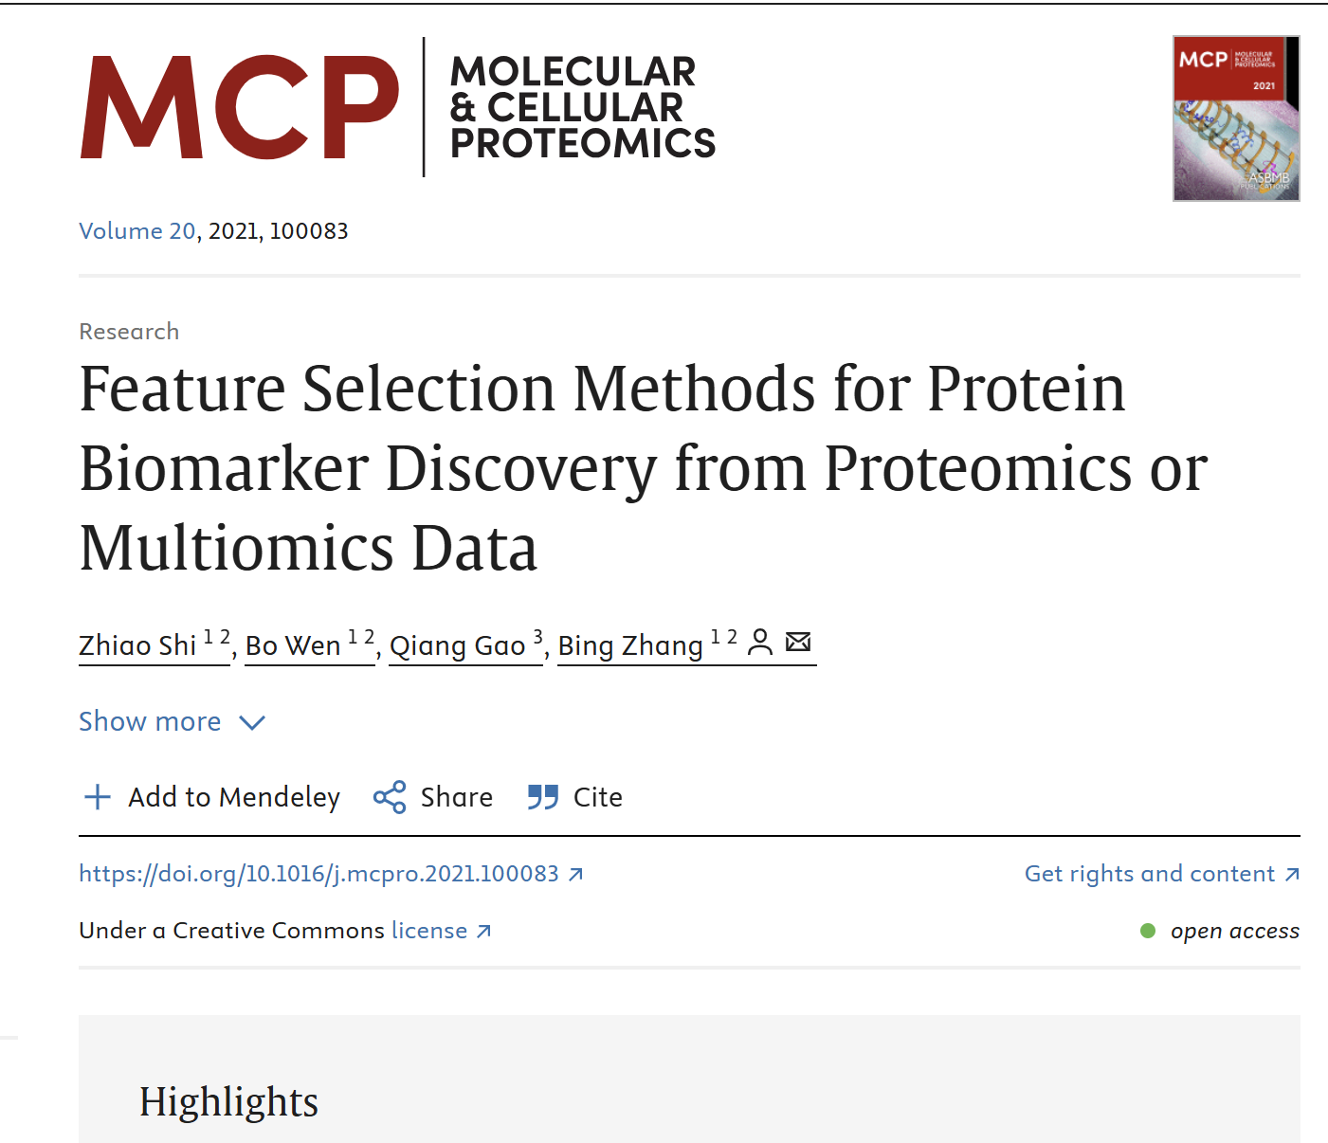
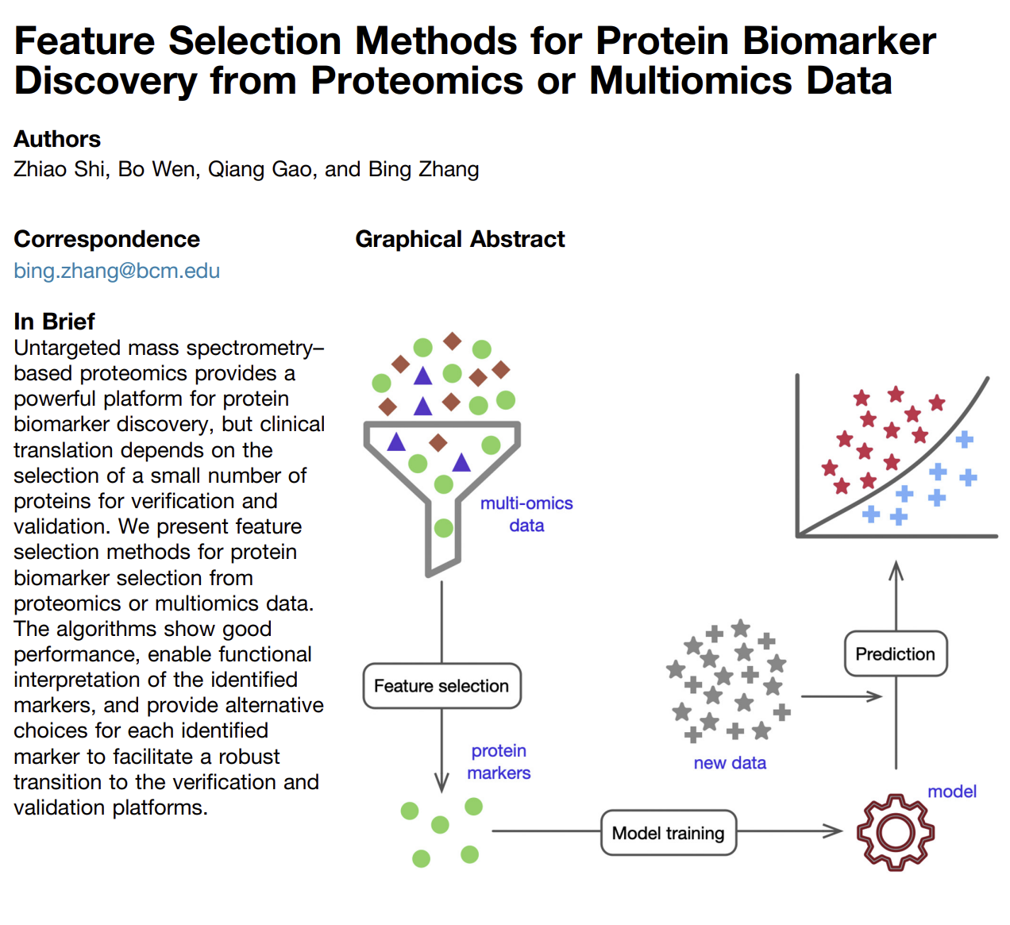

Slide 12

Metabolomics Study

Slide 13
Datasets Used
3Groups-OSCC PM Normal.xlsx: Contains 41 columns representing mixed groups (OSCC, PM, Normal) with 1,378 metabolites per column across two sheets (Positive and Negative).
• TumorVsNAT Metabolomics Tissue.xlsx: Contains 31 columns (mixed Tumor and NAT groups) with 3,771 metabolites per column across two sheets (Positive and Negative).

Slide 14
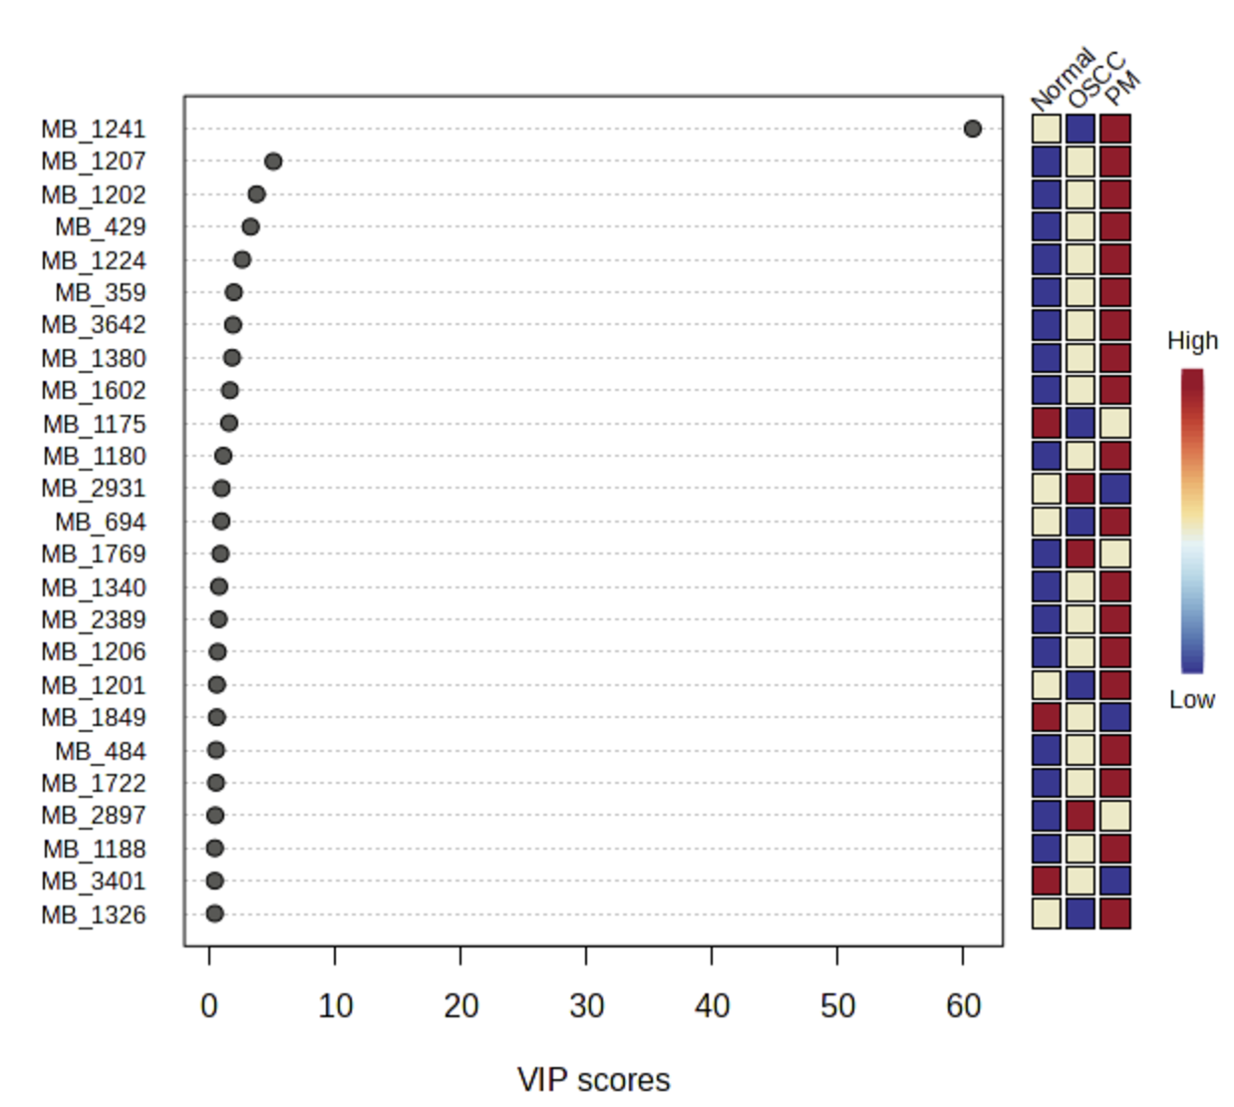
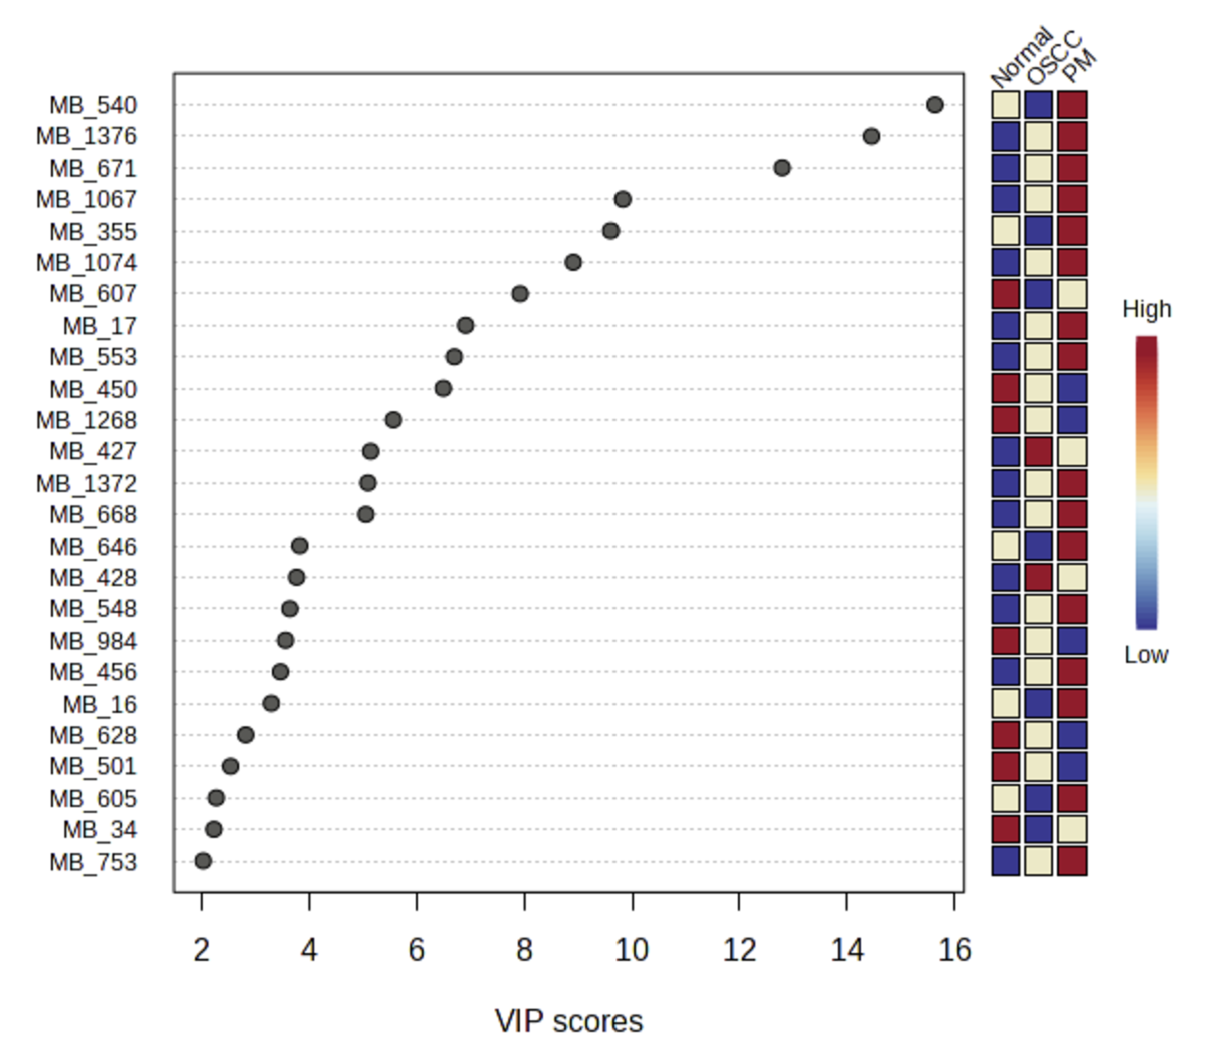
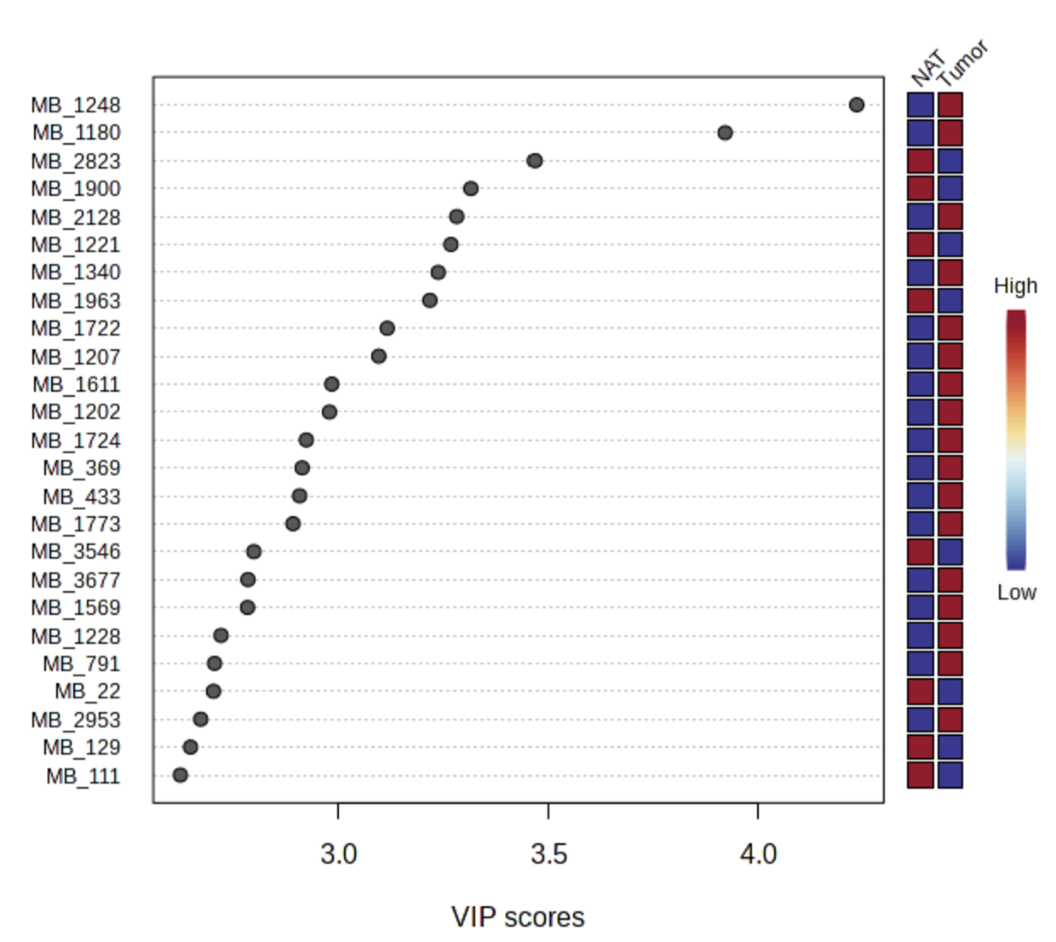
Metaboanalyst:-
For the Tumor vs NAT dataset:– Orthogonal Partial Least Squares Discriminant Analysis (OPLS-DA) was performedin MetaboAnalyst.– Features with V1 scores greater than 1.5 were selected, narrowing the list to the top 490 metabolites.
For the 3Groups dataset:– PLS-DA was applied using MetaboAnalyst.– The average scores across 8 components were calculated, and a threshold of average score> 0.3 was used to select the top 250 metabolites.

Slide 15
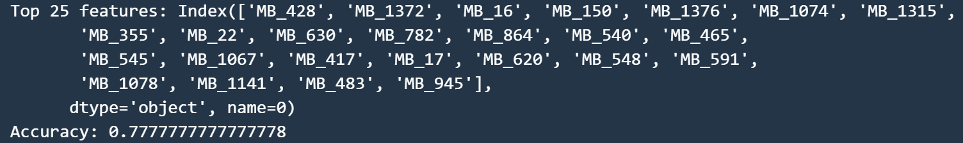
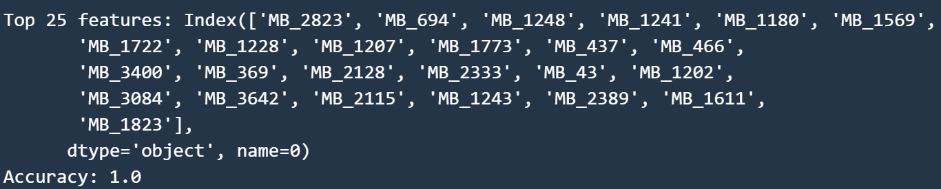
Methodology:-
After finding the top metabolites from the MetaboAnalyst, I used various ML models to further reduce the top metabolites to 25.
I used logistic regression with elastic net regularisation, random forest model, and SVM with the Recursive Feature Elimination technique.
I found the random forest model performing best among these models.
3 groups Positive
3 groups Negative

Slide 16
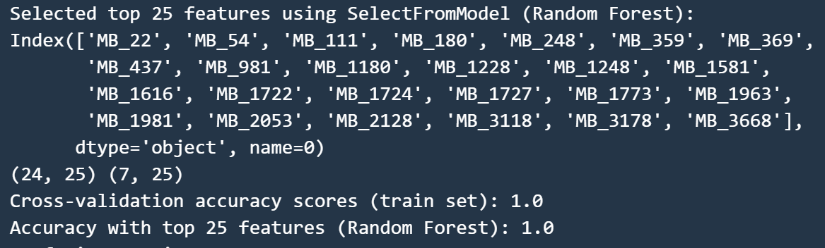
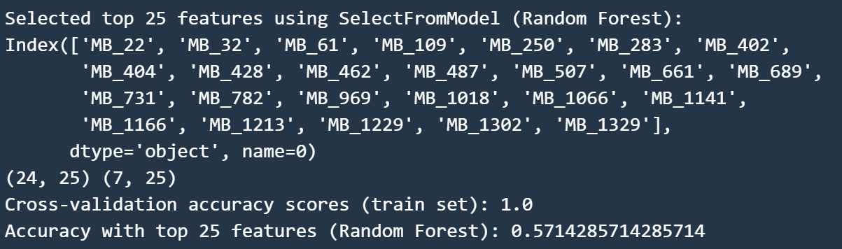
Tum vs Nat Positive:-
Tum vs Nat Negative:-

Slide 17
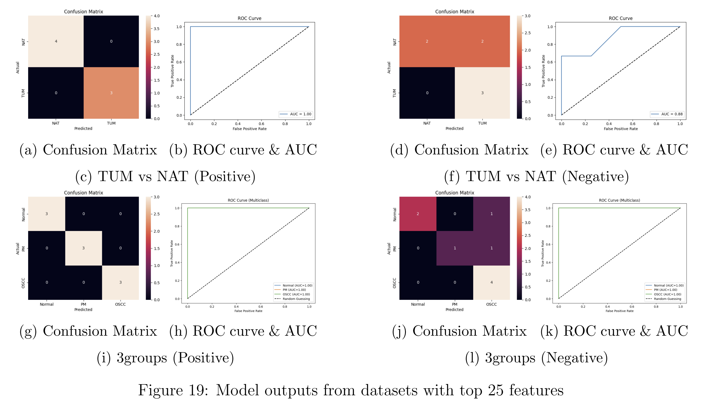
Random Forest model

Slide 18
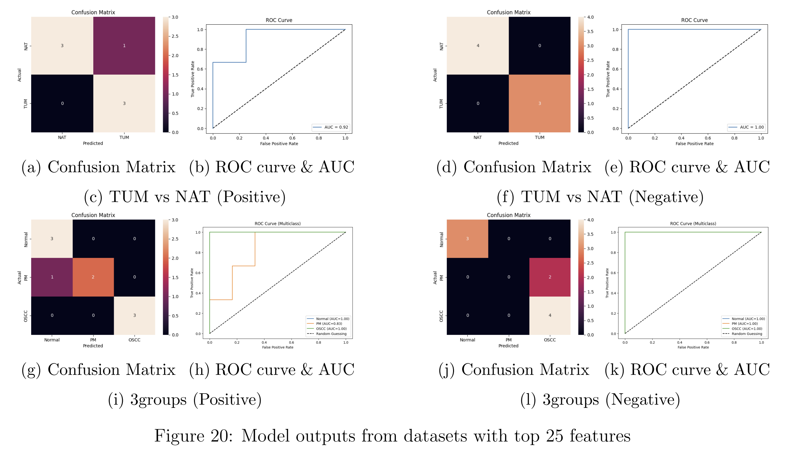
SVM with L1 regularization

Slide 19
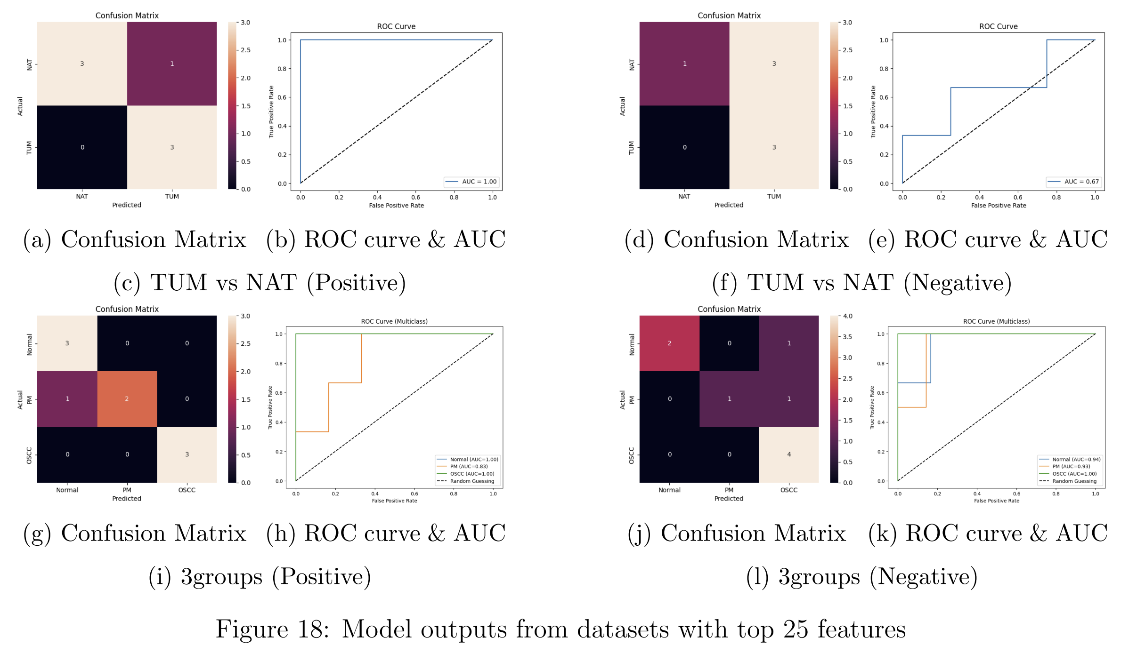
Logistic Regression with Elastic Net regularisation

Slide 20
Thank You

